Slide 1
SOFTWARE DESIGN FUNDAMENTALS
For image processing

Slide 2
1. Lecture overview
During this lecture, students will explore the key principles of software design—ranging from architecture styles to common design patterns—and learn how to apply them to a remote sensing software project. The lecture will emphasize best practices that enable collaboration, scalability, and maintainability, ensuring students have a solid blueprint before diving into heavy coding in the coming weeks.

Slide 3
WHY PACKAGE PYTHON APPS?
Eliminate the need for end users to install Python or manage dependencies.
Improve user experience with a polished, double-clickable installer.
Ensure consistent performance across various Windows machines

Slide 4
Overview of lecture goals
PyInstaller: Bundle Python scripts (and dependencies) into a single executable.
Introduction to GUI Development with Tkinter and PyQt.
Inno Setup: Build a professional Windows installer (with a wizard, Start Menu shortcuts, Uninstall option, etc.).
End-to-End Workflow: Start from a working Python script, end with a ready-to-distribute .exe + installer.
Consider a remote sensing or image processing tool from last semester. Show how we might package it so that non-technical users (e.g., stakeholders, lab colleagues) can install and run it easily.

Slide 5
Overview of lecture goals
PyInstaller: Bundle Python scripts (and dependencies) into a single executable.
Inno Setup: Build a professional Windows installer (with a wizard, Start Menu shortcuts, Uninstall option, etc.).
End-to-End Workflow: Start from a working Python script, end with a ready-to-distribute .exe + installer.
Consider a remote sensing or image processing tool from last semester. Show how we might package it so that non-technical users (e.g., stakeholders, lab colleagues) can install and run it easily.

Slide 6
Pyinstaller fundamentals
What is PyInstaller?
PyInstaller is a Python package that allows us to convert Python scripts (.py) into standalone executables (.exe) that can run on Windows, macOS, and Linux without requiring Python to be installed.
Why Use PyInstaller?
Removes the need for end-users to install Python and dependencies manually.
Ensures compatibility with different environments.
Simplifies software distribution.
Installing PyInstaller
pip install pyinstaller
pyinstaller --version

Slide 7
Pyinstaller fundamentals
Pyinstaller Modes
PyInstaller provides different modes for packaging applications:
One-File Mode (--onefile): Generates a single executable that extracts dependencies at runtime.
One-Folder Mode (Default): Creates a folder containing all necessary files.
Console Mode (--console): Keeps the terminal open (useful for debugging).
Windowed Mode (--windowed): Suppresses the terminal (for GUI applications).

Slide 8
Pyinstaller fundamentals
Console vs Windowed Mode
Console Mode (--console, default):
Opens a command prompt (terminal) when running the .exe.
Useful for debugging because it displays print statements and error messages.
If the program crashes, the error message remains visible.
Windowed Mode (--windowed):
Runs the application without a terminal window.
Designed for GUI applications (Tkinter, PyQt, etc.).
Suppresses error messages and print statements.
If the program crashes, it may close silently without displaying an error.

Slide 9
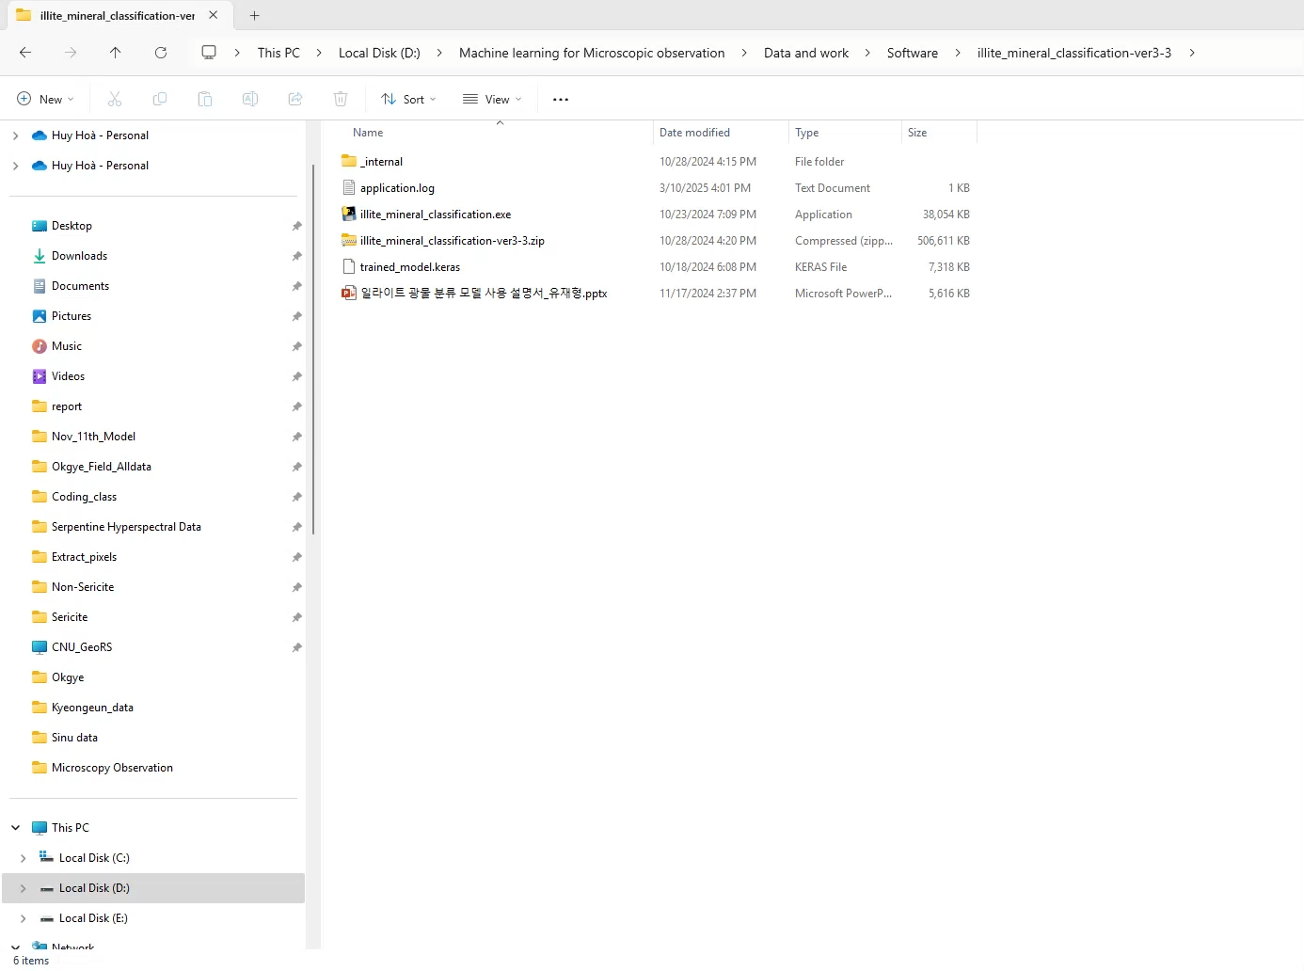

Slide 10
Pyinstaller fundamentals
CONVERTING A SCRIPT INTO EXECUTABLE
Let’s say we have a Python script called image_classifier.py
pyinstaller --onefile image_classifier.py
--onefile bundles everything into a single .exe file.
Additional PyInstaller Options
pyinstaller --onefile --icon=app_icon.ico image_classifier.py
pyinstaller --hidden-import some_module --onefile image_classifier.py
pyinstaller --console image_classifier.py
pyinstaller --windowed image_classifier.py

Slide 11
Pyinstaller fundamentals
Quiz: Applying Pyinstaller for Packing Python Apps.
Question 1: Create an .exe app using Pyinstaller with the script name “Example1.py”, which is located at D:\Software\Example1.py
cd D:\Software
pyinstaller --onefile Example.py
Question 2: Create an .exe app using Pyinstaller with the script name “Example2.py” and specific an application icon located at D:\Software\app_icon.jpg
cd D:\Software
pyinstaller --onefile --icon=D:\Software\app_icon.jpg Example2.py
Question 3: Create an .exe app using Pyinstaller with the script name “example3.py” and include a hidden import file named model.keras, which is located at D:\Software\model.keras. Use the windowed option to suppress the consolde
cd D:\Software
pyinstaller --onefile --windowed –hidden-import=model.keras example3.py

Slide 12
Pyinstaller fundamentals
Quiz: Applying Pyinstaller for Packing Python Apps.
Question 4: Create an .exe app using Pyinstaller with the script name “RS_Lab_Software.py”, and include an application icon + hidden import file. The icon and hidden import file have the same name and directory as Question 1,2 and 3. Use the windowed option and do not use compression in onefile.
cd D:\Software
pyinstaller --windowed --icon=D:\Software\app_icon.jpg --hidden-import=model.keras RS_Lab_Software.py

Slide 13
INTRODUCTION TO GUI DEVELOPMENT with tkinter and pyqt
What is Tkinter?
Tkinter is Python’s standard GUI (Graphical User Interface) toolkit. It provides a simple way to create windows, buttons, menus, text fields, and other interactive elements.
Why Use Tkinter?
Comes pre-installed with Python (no extra installation required).
Easy to use and lightweight.
Ideal for small to medium-sized applications.
pip install tk
Key Tkinter Components
tk.Tk() – Creates the main application window.
tk.Label() – Displays text or images.
tk.Button() – Creates interactive buttons.
tk.Entry() – Accepts user input.
tk.Frame() – Groups widgets together.
tk.Canvas() – Used for drawing shapes and images.
pack(), grid(), place() – Methods for widget layout.

Slide 14
INTRODUCTION TO GUI DEVELOPMENT with tkinter and pyqt
What is PyQt?
PyQt is a powerful GUI library for Python that provides more advanced features and customization options than Tkinter. It is based on Qt, a popular C++ framework.
Why Use PyQt?
More advanced UI components and styling.
Supports complex applications with animations, multi-threading,
More modern appearance and cross-platform compatibility.
pip install PyQt5
Key PyQt Components
QApplication – Manages application-wide settings.
QWidget – The base class for all UI elements.
QLabel – Displays text and images.
QPushButton – Creates buttons.
QLineEdit – Accepts user input.
QVBoxLayout, QHBoxLayout – Layout management.

Slide 15
Choosing between tkinter and pyqt
Feature | Tkinter | PyQt
Ease of Use | Easy to learn | More complex
Installation | Pre-installed | Requires separate installation
Customization | Limited | Highly customizable
Performance | Lightweight | Heavier but more powerful
Best for | Simple applications | Advanced applications

Slide 16

INNO SETUP
What is Inno Setup
Inno Setup is a free script-based installer system for Windows that allows developers to create professional installation packages for their software. It provides features such as:
A graphical installation wizard.
Start Menu and desktop shortcuts.
Uninstall options in the Windows Control Panel.
Customizable installation settings and compression to reduce file size.
Installing Inno Setup
To install Inno Setup:
Download Inno Setup from the official website:
Inno Setup Downloads
Install it on your Windows system.
Open the Inno Setup Compiler after installation.

Slide 17
INNO SETUP
What is Inno Setup
Inno Setup is a free script-based installer system for Windows that allows developers to create professional installation packages for their software. It provides features such as:
A graphical installation wizard.
Start Menu and desktop shortcuts.
Uninstall options in the Windows Control Panel.
Customizable installation settings and compression to reduce file size.
Installing Inno Setup
To install Inno Setup:
Download Inno Setup from the official website:
Inno Setup Downloads
Install it on your Windows system. Then open the Inno Setup Compiler after installation.

Slide 18
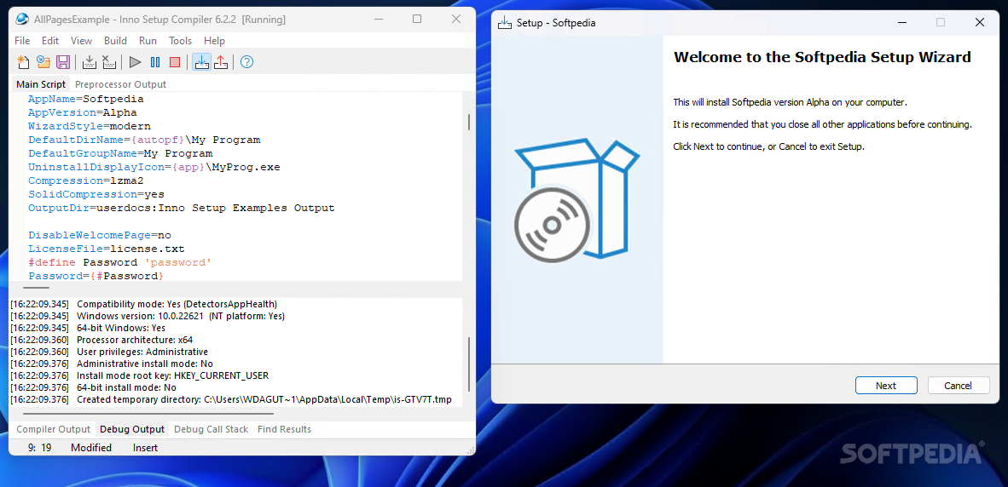
INNO SETUP
Writing an Inno Setup Script
Once you have an .exe file from PyInstaller, follow these steps to create an installer:
Open Inno Setup Compiler.
Click File → New to start a new script.
Use the Wizard or manually write a script.
Compiling and Testing the Installer
Click Compile in Inno Setup.
This will generate an installer (Setup_MyApp.exe).
Run the installer on a test machine.
Verify that:
The software installs correctly.
The desktop and Start Menu shortcuts work.
The uninstall option is available in Control Panel → Programs and Features.

Slide 19
END-TO-END WORKFLOW: FROM PYTHON SCRIPT TO DISTRIBUTED SOFTWARE
Overview
Core Functionality
Writing function to handle
Tkinter
Integrate functions into Tkinter-based interface
Pyinstaller
Compile and test
Inno Setup

Slide 20
END-TO-END WORKFLOW: FROM PYTHON SCRIPT TO DISTRIBUTED SOFTWARE
EXAMPLE
We will develop a simple GUI screen to allow users Enter their name and submit it.
import tkinter as tk
from tkinter import ttk
def example_function():
print(“You has submitted your name!")
root = tk.Tk()
root.title("Tkinter Example")
# Label
ttk.Label(root, text="Enter your name:").grid(row=0, column=0, padx=5, pady=5, sticky="W")
# Entry field
name_entry = ttk.Entry(root, width=30)
name_entry.grid(row=0, column=1, padx=5, pady=5)
# Button
ttk.Button(root, text="Submit", command=example_function).grid(row=0, column=2, padx=5, pady=5)
root.mainloop()

Slide 21
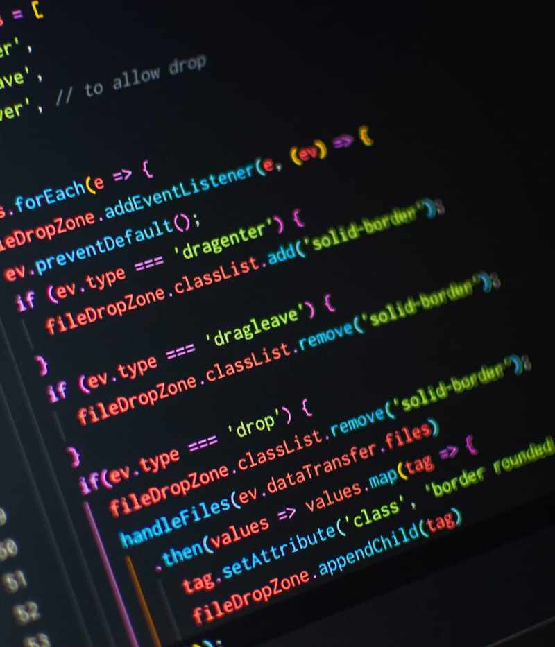
ASSIGNMENT
1. Set up environment + pyinstaller for your laptop.
2. Install all of the libraries from last semester.
3. Learn and remember today’s lecture.
4. Follow the examples in the lecture and submit the code and results.

